Slide 1

ATTE NDANCE SYSTE M
MAKING ONLINE TEACHING EASIER

Slide 2

“Teaching is not a lost art, but the regard for it is a lost tradition."
JACQUES BARZUN

Slide 3

HOW IT ALL STAR TE D
Due to these harsh conditions of the
shifted
pandemic, all our classes are online.
So to help teachers with attendance we have created this.

Slide 4
PR OBLE M
For teachers, it is really hard and time-consuming to mark attendance for around 60 students per class one by one during an online class.
They either call the name of students one by one or tell students to type their names in the chatbox from there teachers note the attendance to their records roll number wise which is a tiresome task for teachers.

Slide 5
OUR SOLUTION
We have created an online attendance recorder system that automatically records the attendance of the students attending the class at that particular point in time.
Our webpage will save the attendance data into an excel sheet name and section-wise hence making the attendance an easy and less tedious task for teachers.

Slide 6
TE CHNOLOGY USE D
web scraping:-Web scraping is an automated method used to extract large amounts of data from websites. The data on the websites are unstructured. Web scraping helps collect these unstructured data and store it in a structured form.
WebAutomation:- It is used for scraping dynamic web pages. In the dynamic web, pagesJavaScript is used. Web Automation is done with the help of selenium library and chrome driver.
WebSockets:- WebSocket is a computer communications protocol, providing full-duplex communication channels over a single TCP connection.

Slide 7
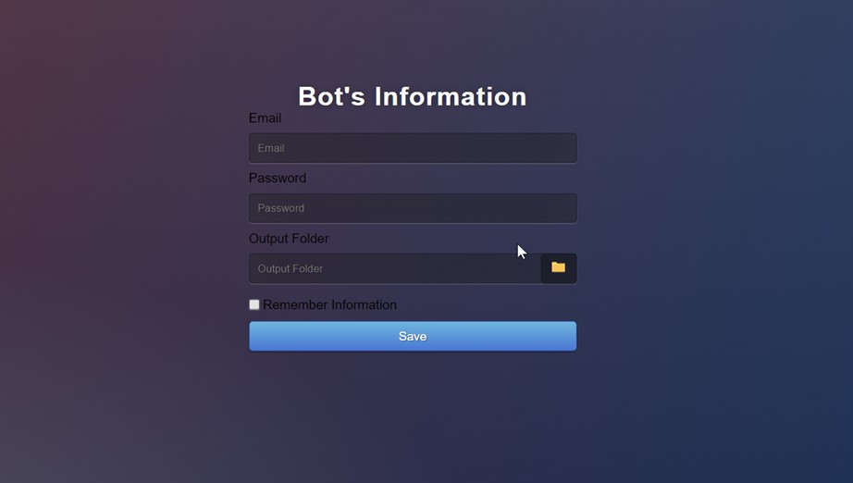
BASIC WOR KING
Here you have to enter the details of the bot which will enter into the meeting.
we have to enter email and password and we have to select an output folder where the attendance Excel sheet and Screenshot should save.

Slide 8
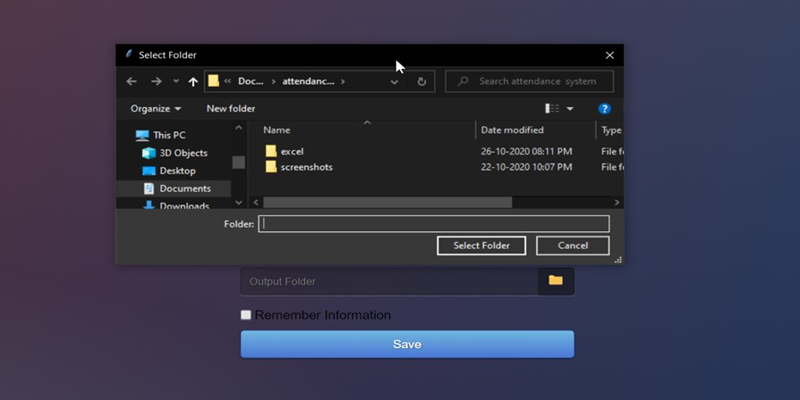
Here we have to select the output folder where the data should be saved in form of excel and screenshots.

Slide 9
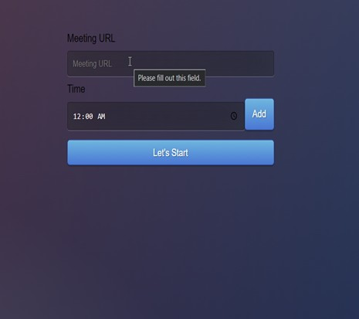
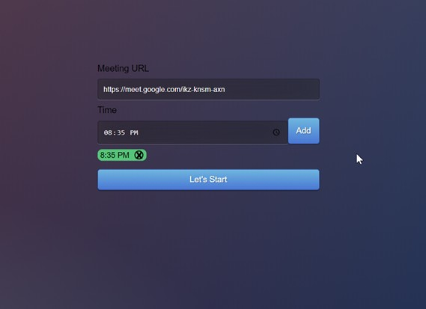
Here you have to enter the URL of the Meeting and the time at which attendance has to be taken. We can even take attendance multiple times during the Meeting.

Slide 10
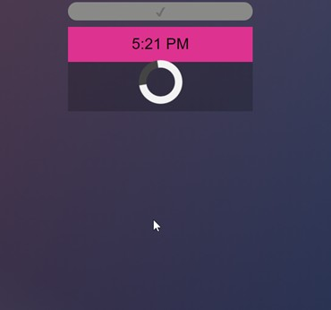
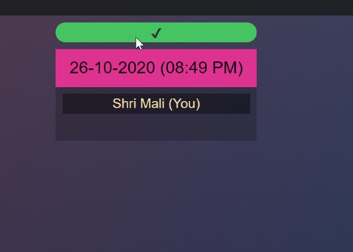
Here we have to select the output folder where the data should be saved in form of excel and screenshots.

Slide 11
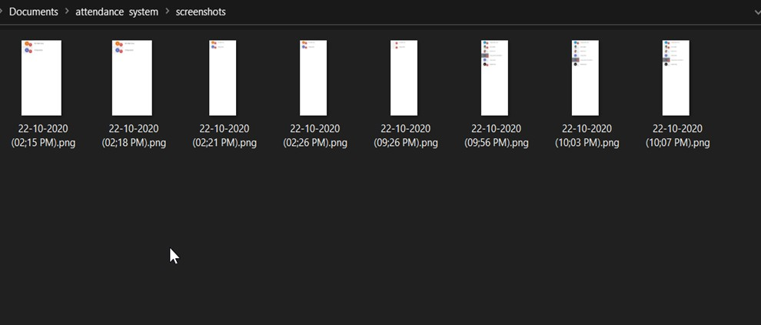
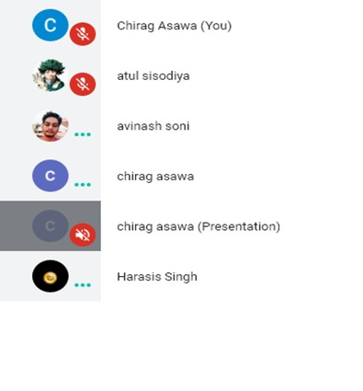
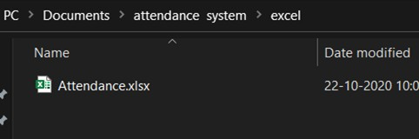
Screenshots of attendees list form google meet

Slide 12
FUTUR E ADDITIONS
AUTOMATION
Bot will automatically detect the ending of a meeting by duration and randomly takes the attendance. So that no student can cheat the system.
ALERT SYSTEM
Automatic Alert system that will warn the student about her shortage of attendance through the mail.
DEDICATED AREA
Dedicated area for teachers to upload all the student related information on the cloud for easy access
PRIVATE INFORMATION
Students can access all their information such as marks, their attendances, teacher remarks, etc

Slide 13



